Slide 1
Exploring restaurants in Manila, Philippines
BY ADEAGBO B. RAPHEAL

Slide 2
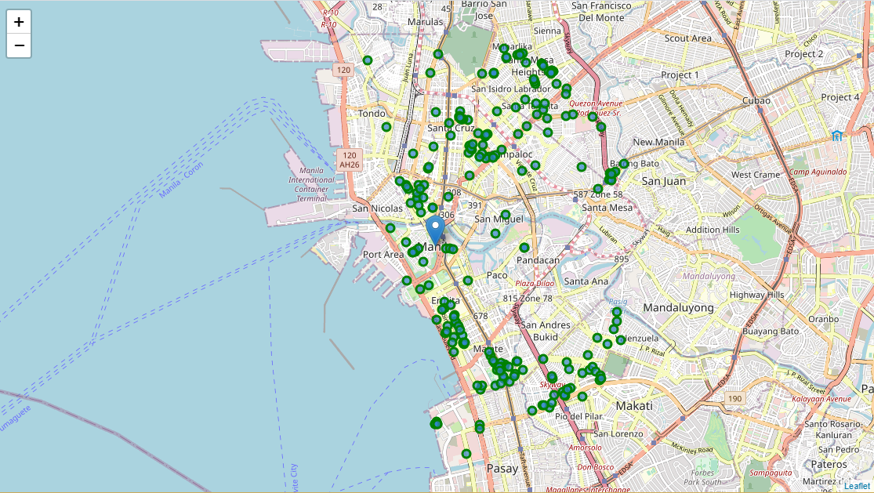
Venues Extracted from Foursquare API
There were 232 venues gotten from Foursquare API during extraction. This data consists of the names, categories, longitude and latitude of the venues

Slide 3
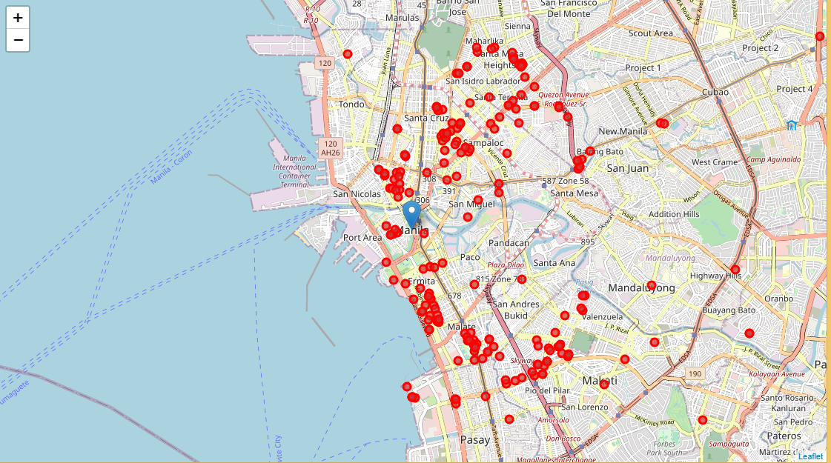
Venues Extracted from Zomato API
The data extracted on Zomato are venue name, latitude, longitude, price for two, price range, price for two, rating and address. This information was extracted for 232 restaurants too

Slide 4
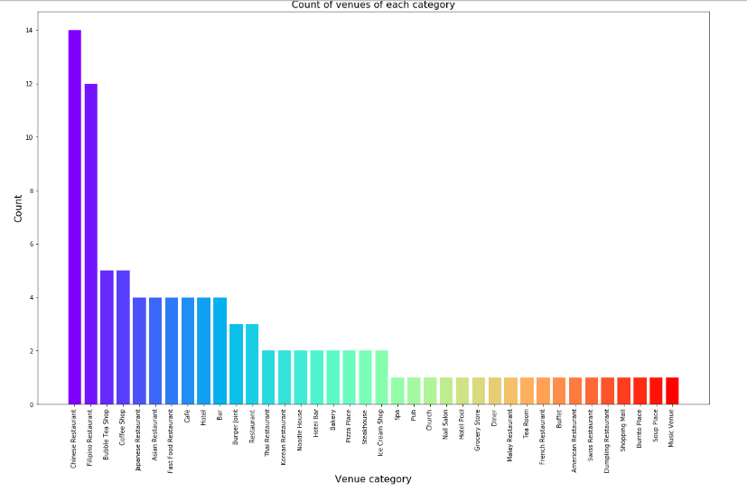
Classification of Venues by category

Slide 5
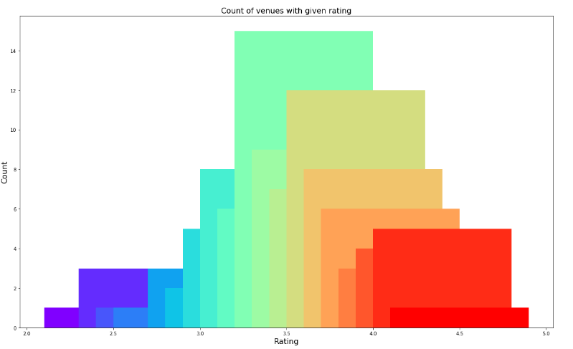
Classification of Venues by Rating

Slide 6
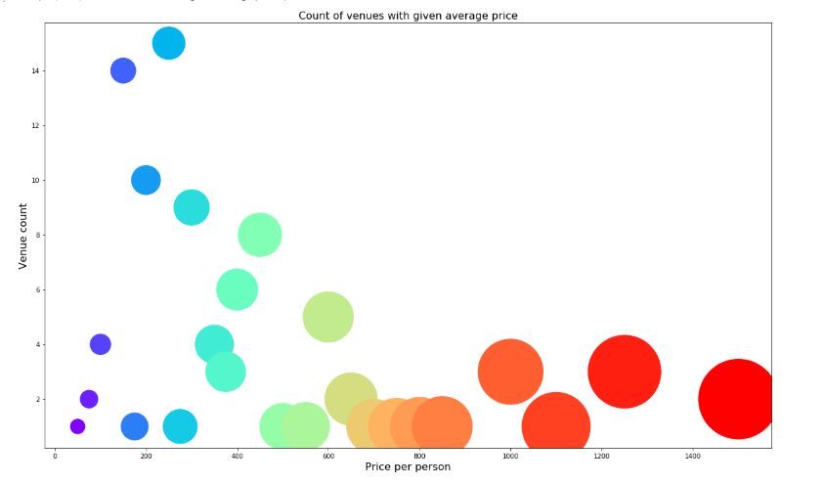
Classification of Venues by price

Slide 7
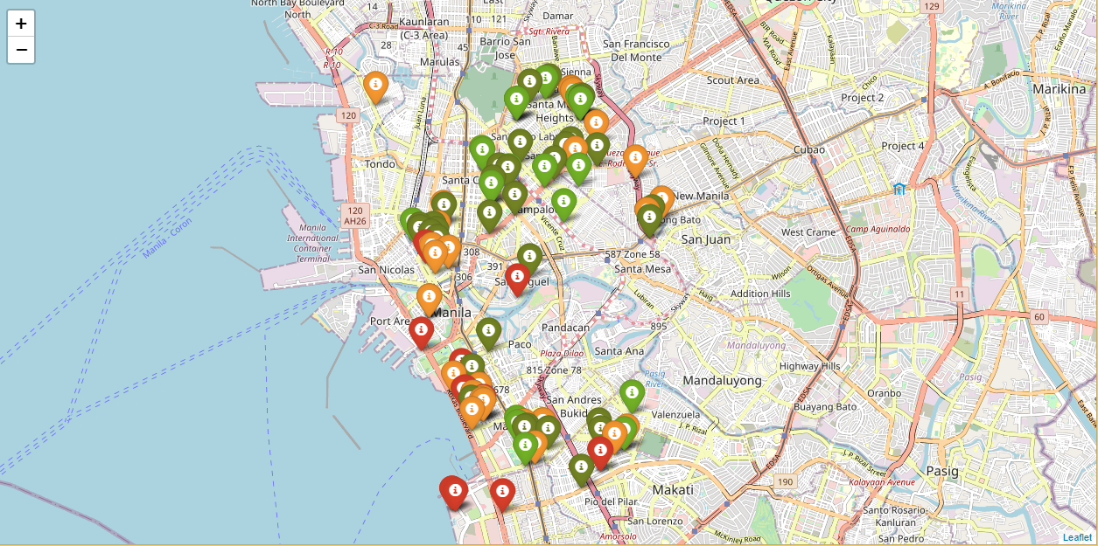
Average Price of venues RATINGS CODE: Dark Green ➔ low, Green = moderate, Orange = high, Red = Very high

Slide 8
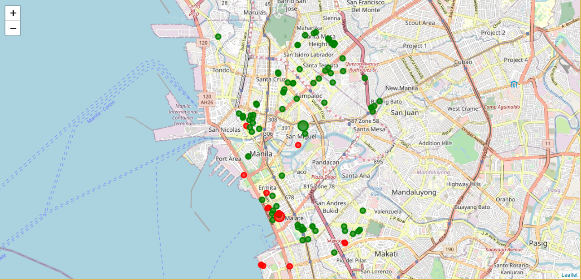
Cluster of venues Showing relationship based on price of restaurants’ menu.

Slide 9
Project’s conclusions
The purpose of this project was to explore the places that a person visiting Manila could visit or stay.
The venues have been identified using Foursquare and Zomato API and have been plotted on the map.
Expensive venues are located close to the sea while moderate and low venues are located further away from the sea.
The map reveals that there are three major areas a person can visit or stay: San Isidro Labrador, Binondo and Malate. Based on the visitor's venue rating and price requirements, he/she can choose amongst the three places.

